Slide 1
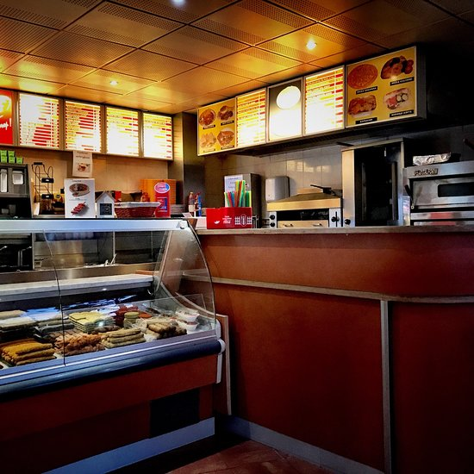
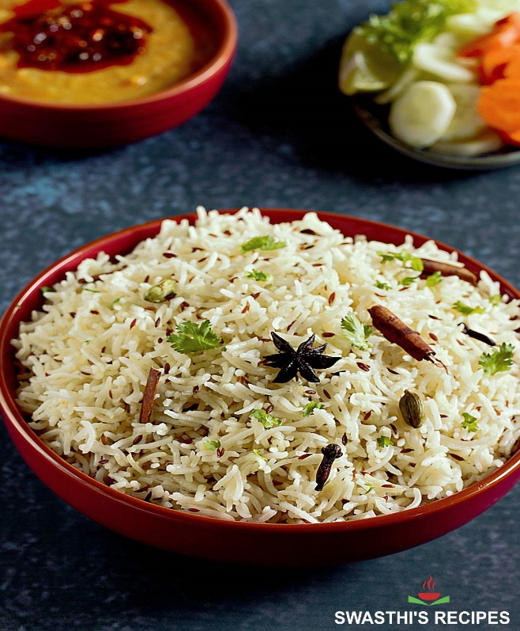
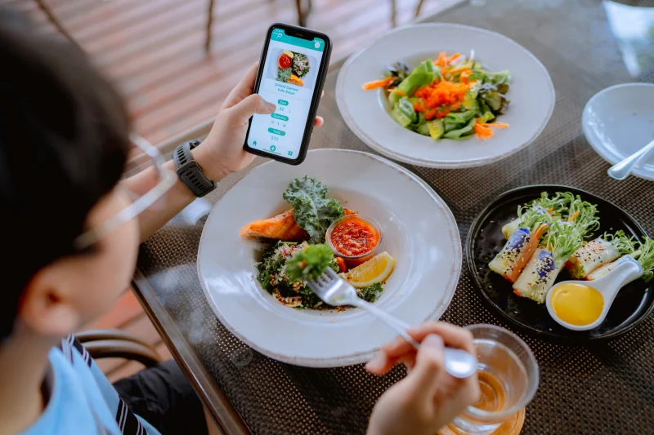
KIU Smart Cafeteria
Notes:
NOTE: To replace a picture, just select and delete it. Then use the Insert Picture icon to replace it with one of your own!

Slide 2
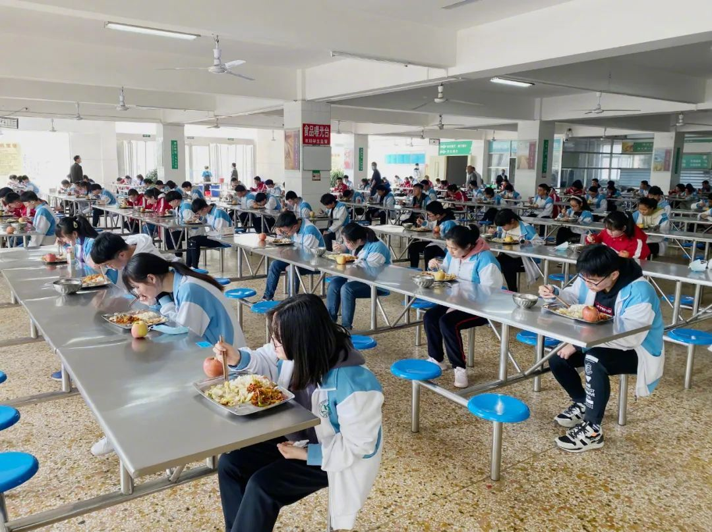
Content
Introduction
Client requirement
Our Solution
Technologies/Software
Objectives
Function
Timeline
Challenges & Issues
Future Development
Summery

Slide 3
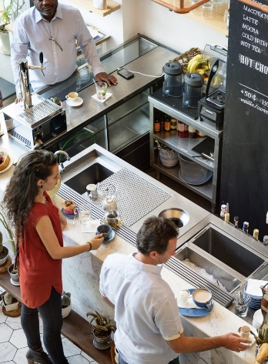
Introduction
KIU smart cafeteria is a web-based application. Today world becoming more technological with in new inventories of IT industry, based on that, we are planning to transform KIU Cafeteria process to Smart process with technological touch.
The main stacks holders of this website on are university student, lectures , other staff, security person and cafeteria staff.
Using this system users can do their day today work easily, productively, and efficiently.

Slide 4

Client requirement:
Need a system to organize lunch preparations correctly.

Slide 5
Our Solution:
First, we research about the cafeteria’s current situation then we recognized few areas should be developed. In manual system,
orders can be lost,
after placing order hard to change orders or cancel,
there can be huge food and money waste,
lack of knowledge of products,
there is no evidence to prove payments,
hard to give feedbacks
After identifying those weakness our main goal is to provide trustworthy comfortable system to the both parties reducing theses weakness. Therefore, we present KIU Smart Cafeteria Project. Through out this presentation you can have more clear idea about this System.

Slide 6
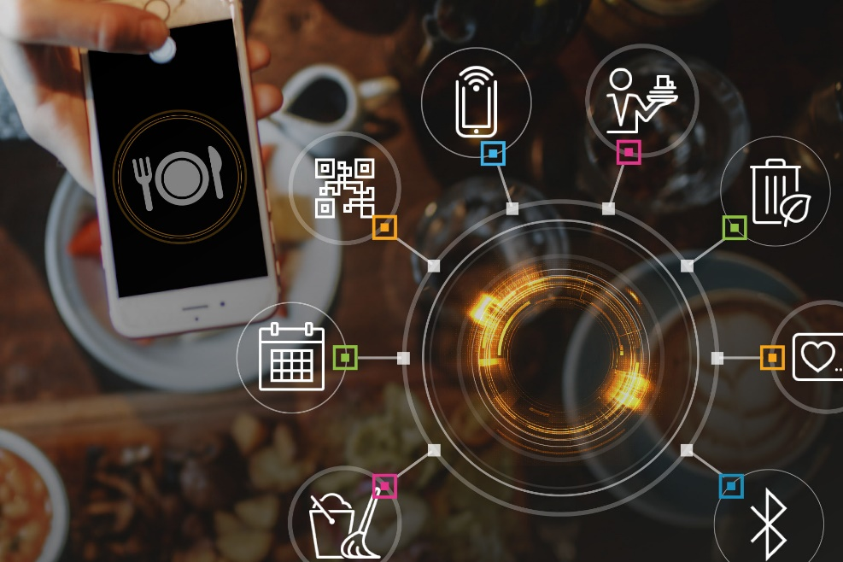
Technologies/Software
We are planning to follow the Water fall model.
For developing purpose, we use few software. Those are Visual Studio Coding, MYSQL Database, GitHub.
To develop this web-based application we mainly use few languages. We use HTML to create web content, CSS and Bootstrap use to create interface design mainly, and PHP, Java(Springboot) and JavaScript(React) use as main coding languages and SQL will be the database language.

Slide 7
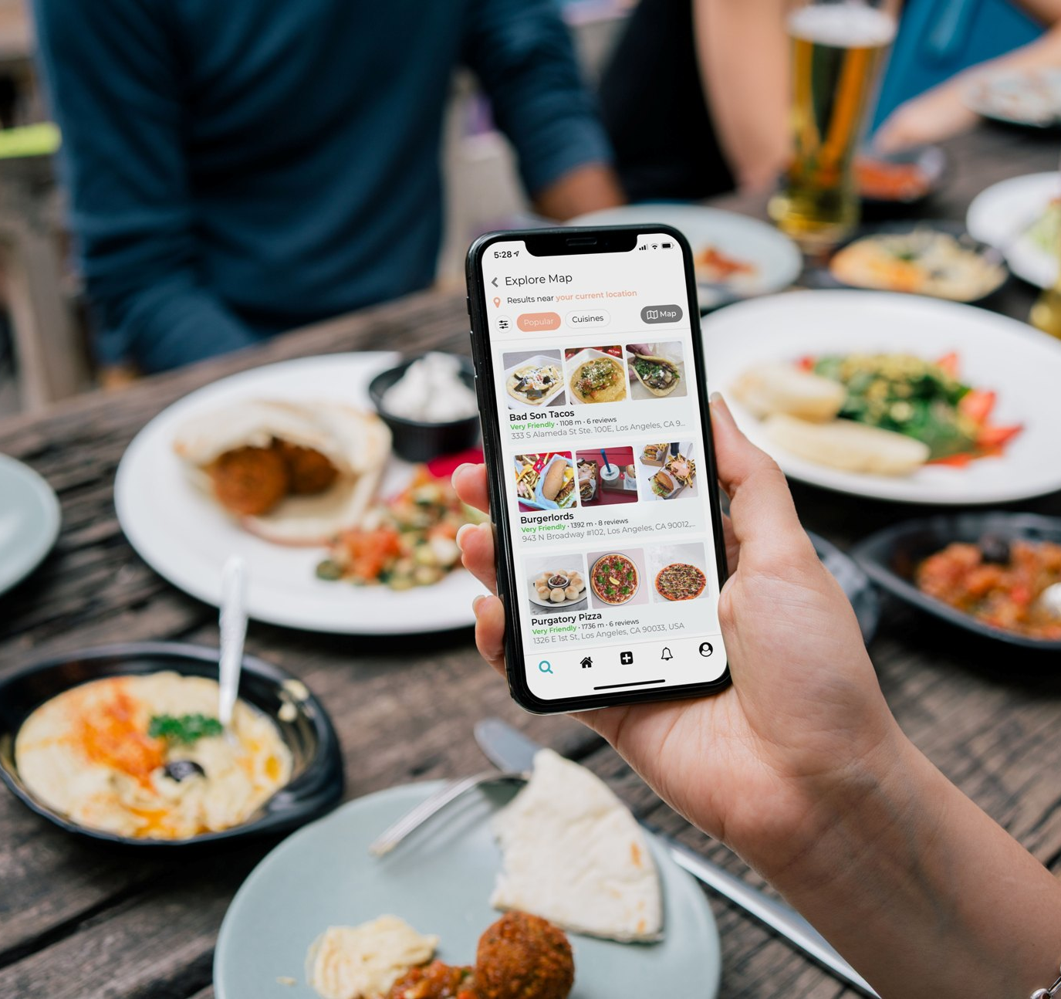
Objectives
The main reason of developing this system is,
to convert manual process of the cafeteria to auto version , we are expect to reduce the weakness of the manual process.
Save time
To supply foods according to the customer needs
Keep clear records of transaction
High productivity
Easy to develop business
Gain customer trust

Slide 8
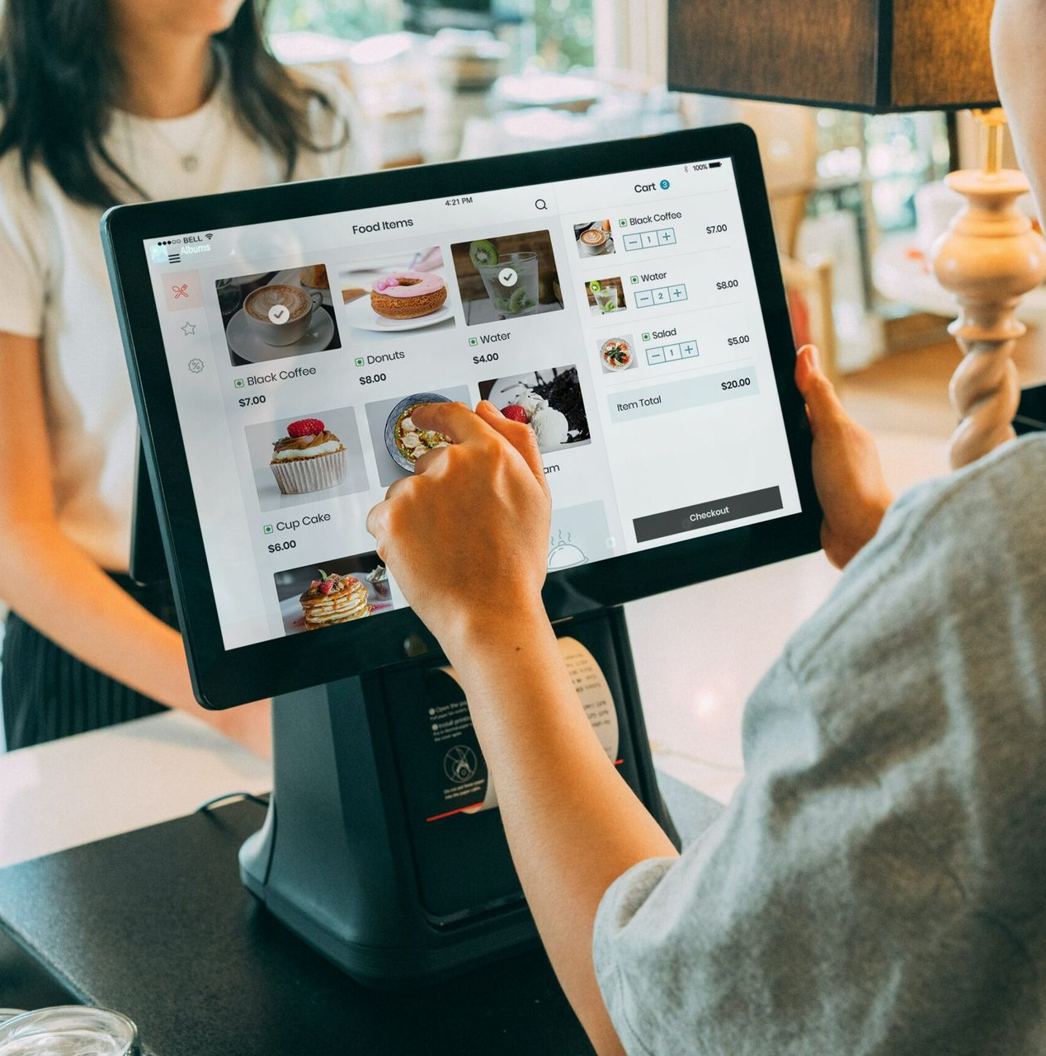
Functions
Mainly this application provides 6 main functionalities. Those are,
Registration and log in
Online Order
Quantity for lunch(functionality of admin )
Billing for lunch(functionality of admin )
Vendor Registration(functionality of admin )
Review

Slide 9

Home
KIU Smart Cafeteria
Log In
Log Out
Home
About Us
Online Ordering
Review
RICE
KOTTU
OTHER

Slide 10
Registration
Firstly user has to perform log in and registration process to use functionalities of the system.
Log In
Register
Index
Index:
.
.
.
Password
Register now
Log In
NIC:
Submit

Slide 11
Online Order
In this function user can place their online order for their lunch meals.
Online Order
Date: …..
Token
Index
Description
Item:
…..
Quantity:
Submit

Slide 12
Quantity for lunch
After ordering, mainly the admin can know the quantity of foods to be supplied. Also admin will perform few functions too.
Quantity For Lunch
Item For Home Page
delete
delete
delete
Count:
+
+
Remain:

Slide 13
Billing for lunch
At the food delivering, using system admin can issue the bill. All these data are recorded in the database.
Bill
E-mail/Message
Date: …..
Index
All Bill Records
Item:
…..
Quantity:
Submit
Total:

Slide 14
Vendor Registration
In this function vendor who provide products can register to the system. This function mainly done by cafeteria staff.
Vendor Registration
Vendor
Name:
……
Edit
Delete
Item:
Edit
Delete
Submit
+

Slide 15
Reviews
Finally, users can give their feedback in here.
Review
Comment:
Submit

Slide 16

Timeline

Slide 17
 | M1 | M2 | M3 | M4 |  |  |  | M5 |  |  |  |  |  |  |  | M6 | M7
 | 28.02 | 07.03 | 14.03 | 21.03 | 28.03 | 4.04 | 11.04 | 18.04 | 25.04 | 02.05 | 09.05 | 16.05 | 23.05 | 30.05 | 06.06 | 13.06 | 20.06
Week | 1 | 2 | 3 | 4 | 5 | 6 | 7 | 8 | 9 | 10 | 11 | 12 | 13 | 14 | 15 | 16 | 17
Topic Selection | 4 day
Research | 3 week
Proposal presentation | 1week
Project proposal | 2week
Diagrams(ER, Use Case, Sequence) | 3week
SRS document | 4 week
Prototypes | 8 week
Implementation |  |  | 12week
Testing |  |  |  |  |  |  |  |  |  |  |  |  | 4 week
Final Report |  |  |  |  |  |  |  |  |  |  |  |  |  |  | 3 week
Final presentation |  |  |  |  |  |  |  |  |  |  |  |  |  |  |  |  | 1week

Slide 18
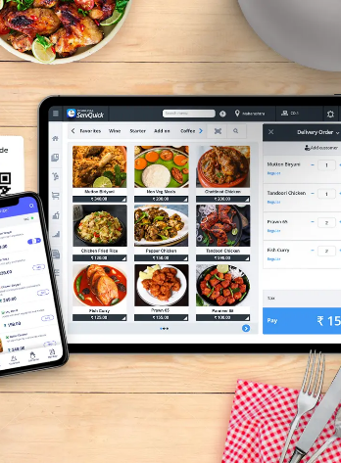
Future Development
As for future development we can add online payment system to the current system.
We can display food products on screen near cafeteria.
Also we can introduce touch screen menu selection process to the customers.
Also we can spread our menu and products furthermore.
Introduce bonus process.

Slide 19
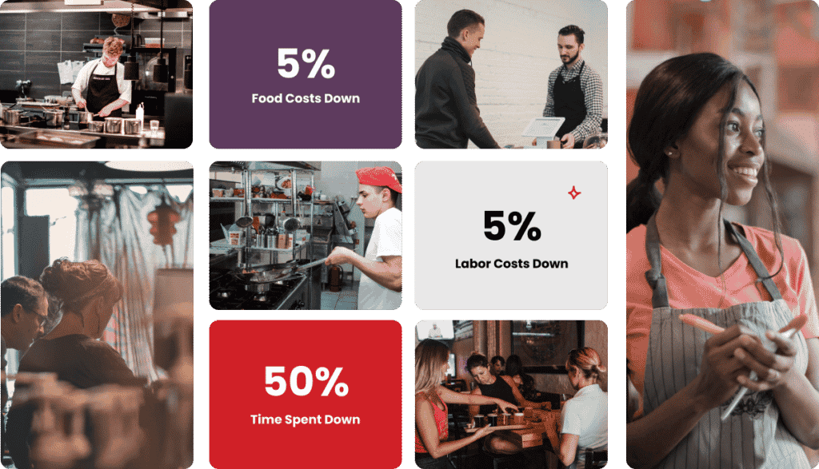
Challenges & Issues
Technologies issues
Difficulties in finding information
Lack of resources
Lack of knowledge in web developing

Slide 20
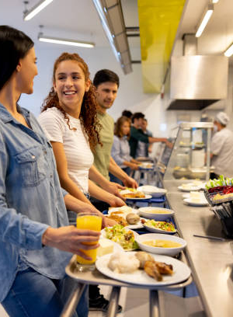
Summery
KIU Smart Cafeteria provide easier effective advance online food ordering system with secure service .
Through out this presentation we present the value of this system ,its advantages and its performance .
With varies functions and features the system ensures the customers sign out with the content heart, getting all the requirement of them fulfilled.
Also, in the future we can use this system developing furthermore.

Slide 21
Thank You

